Slide 1

Presented by:-
Aniket
Analyst Trainee(Capgemini)

Slide 2
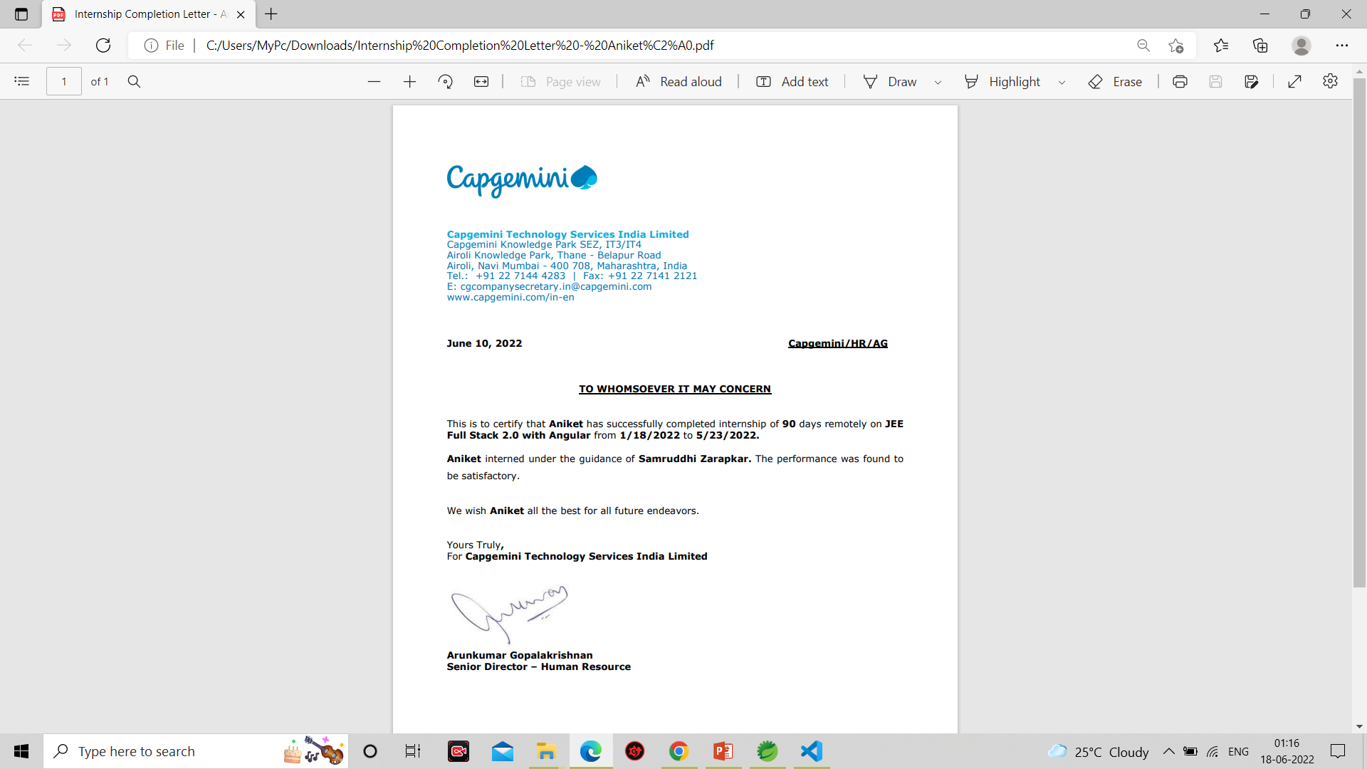
Internship Certificate:

Slide 3

E-Shopping Zone
The name of my Web Application is E-Shopping Zone.
E-Shopping Zone is an E-Commerce Web Application.

Slide 4
Technologies Used:
Backend : 1. Spring boot micro service
2. Eureka Server
3. Spring Cloud API Gateway
4. Swagger
5. Mongo DB
Frontend : 1. Angular
2. Bootstrap

Slide 5
There are two role in this Web Application –
Login/Signup
Add to Cart
Buy Prod
1.Merchant
2.Customer
Add Prod
Delete Prod
Update Prod

Slide 6
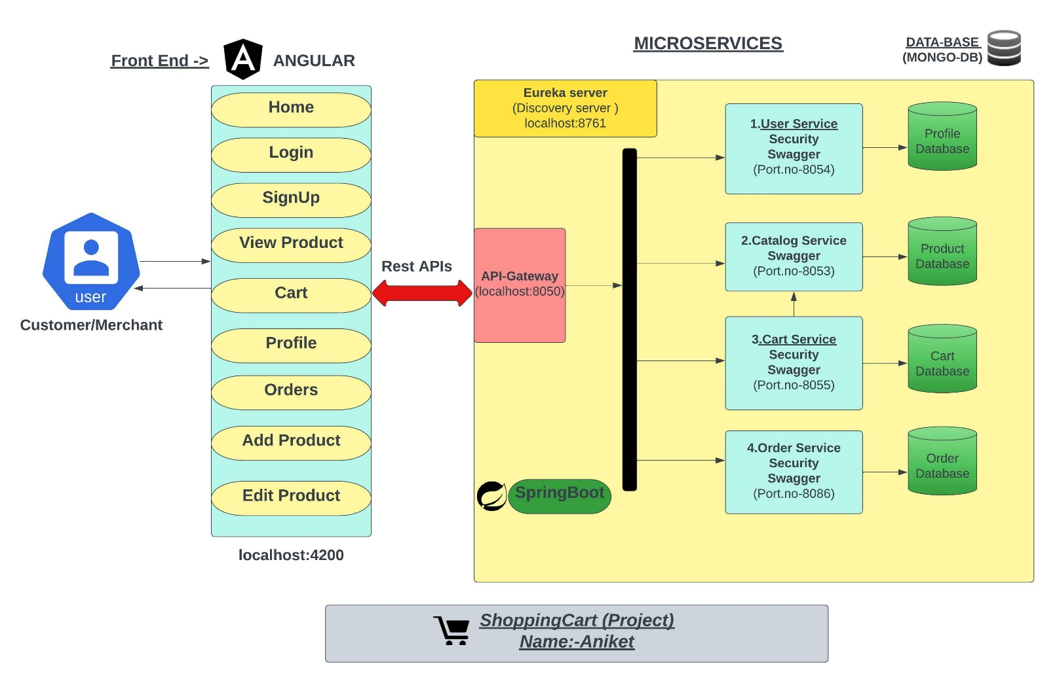
Architectural Diagram:-

Slide 7
Project Overview:-

Slide 8
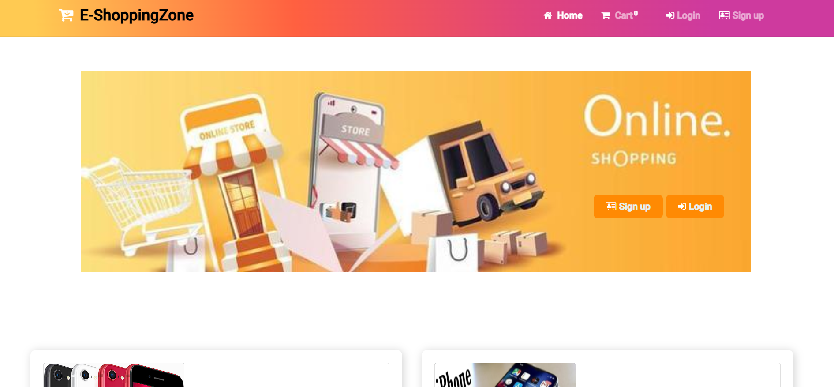
Home Page:

Slide 9
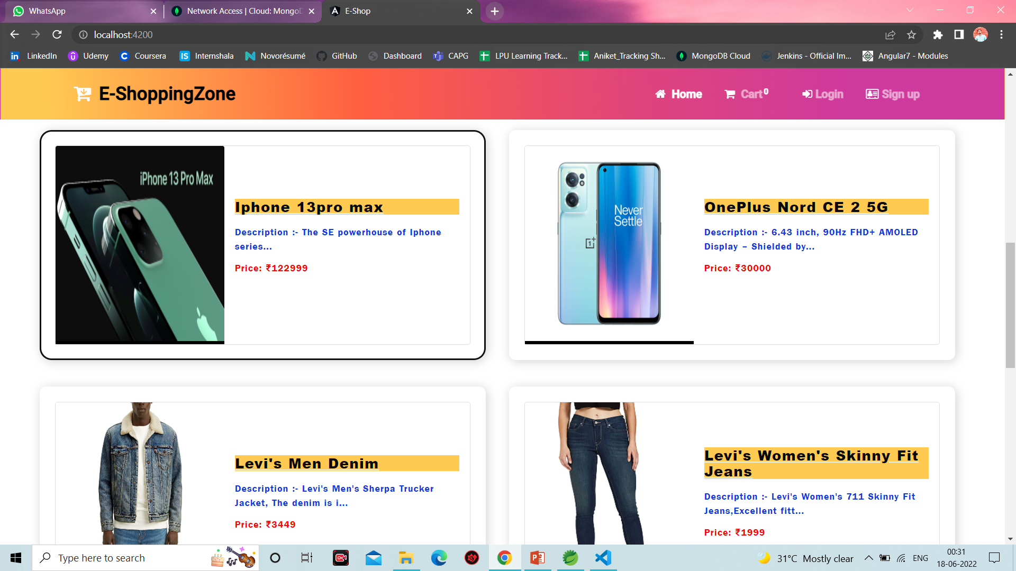
Dashboard Page:-

Slide 10
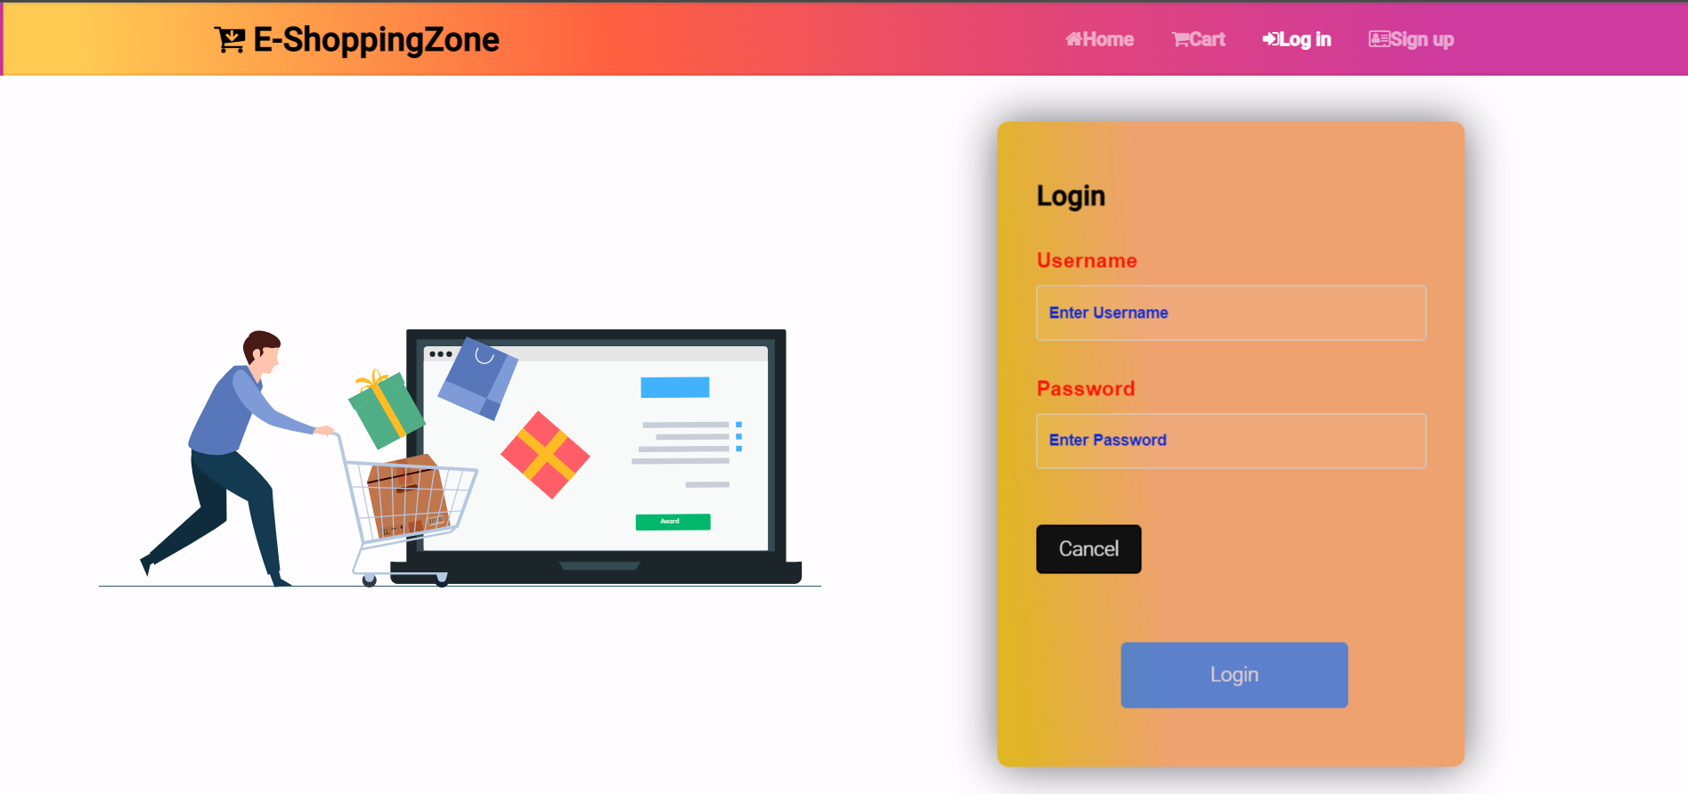
Login Page:

Slide 11
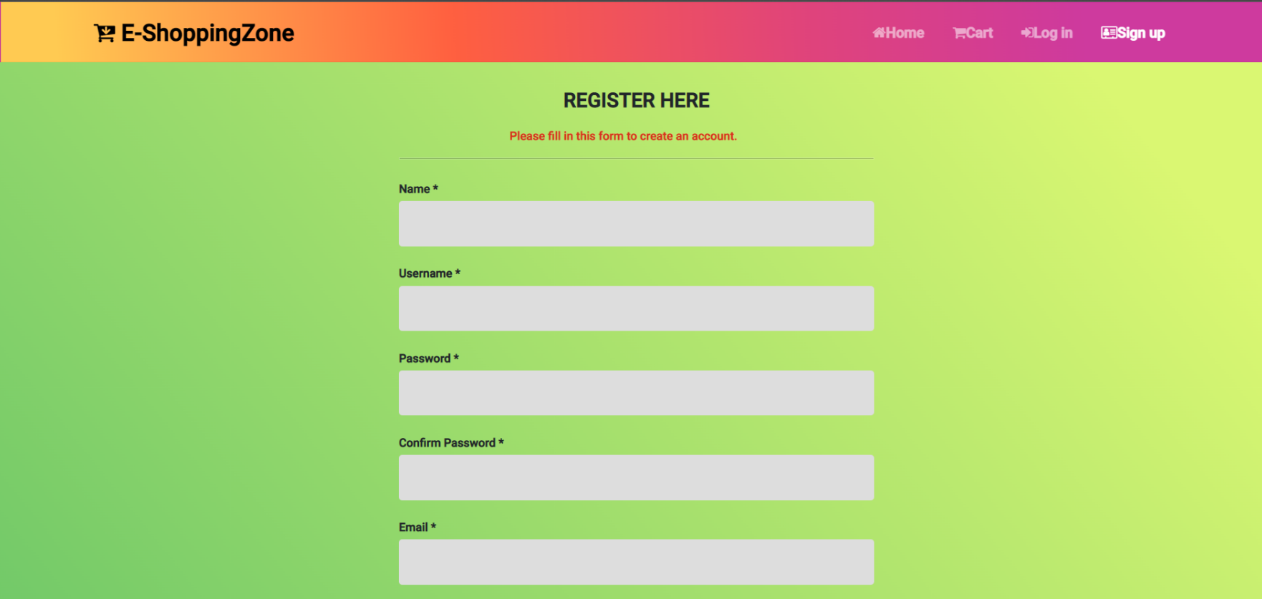
Registration/Signup Page:-

Slide 12
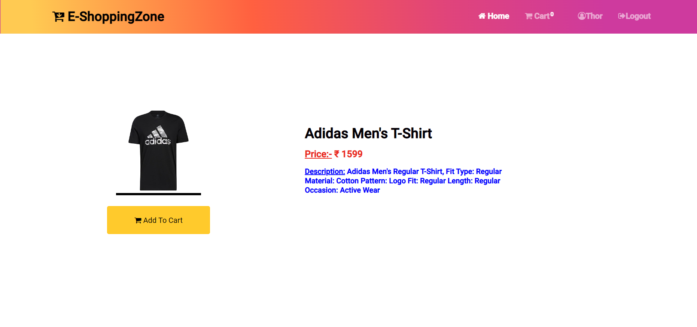
Product Details Page:-

Slide 13
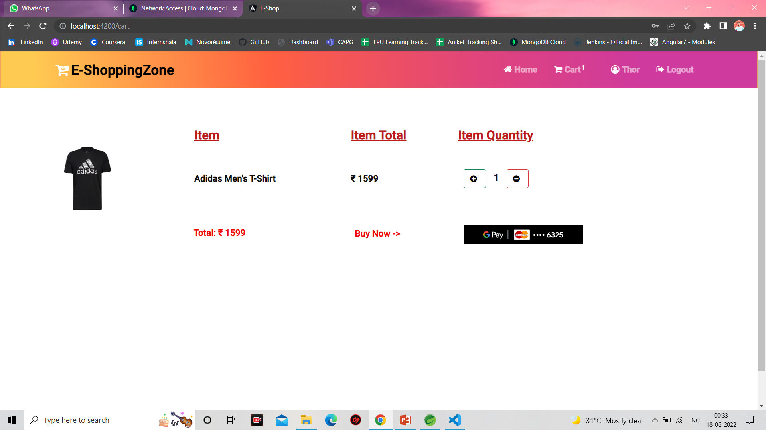
Add to cart Page:-

Slide 14
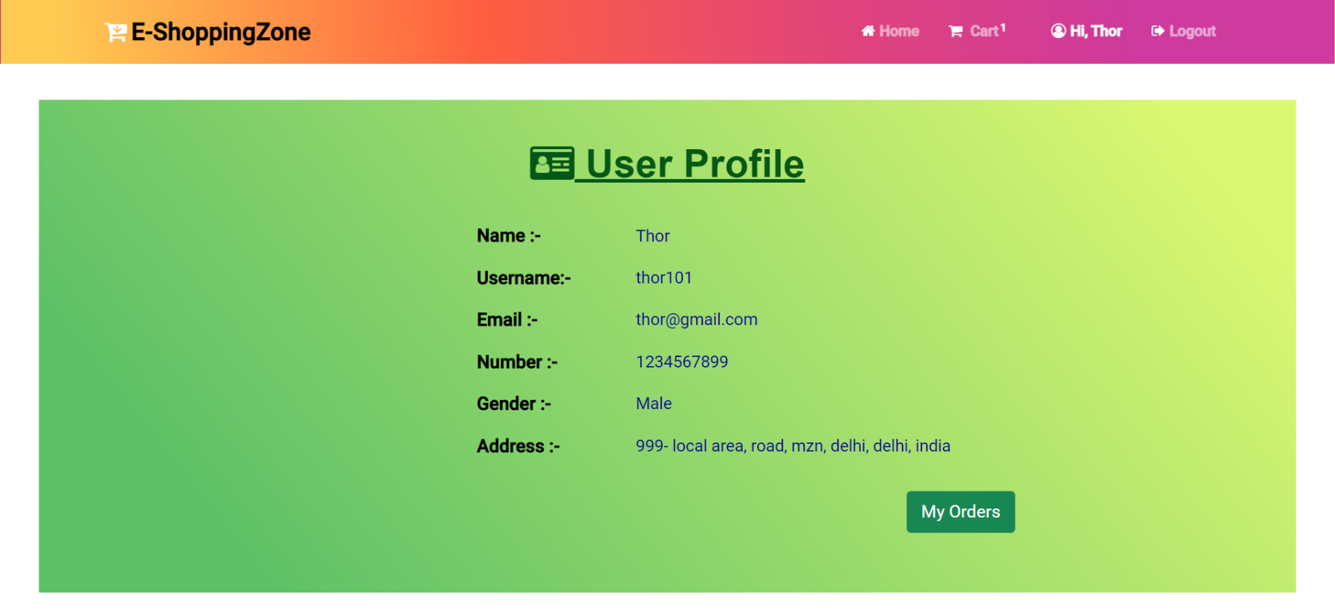
User Profile Page:-

Slide 15
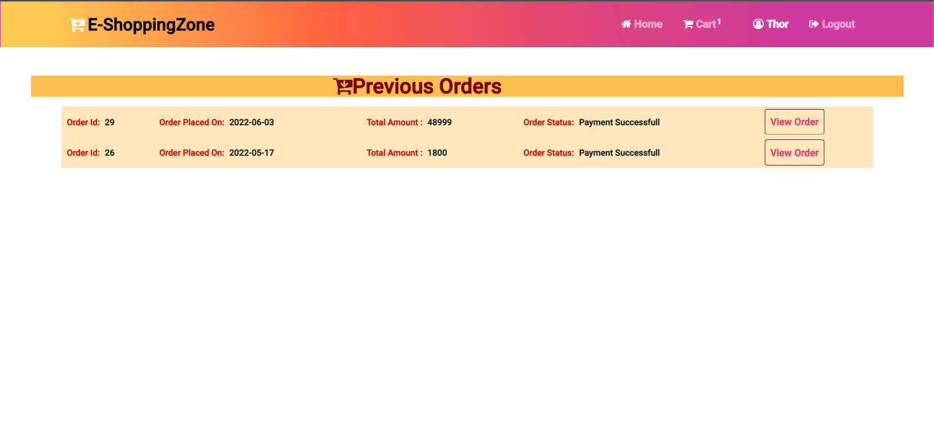
Order Details Page:-

Slide 16
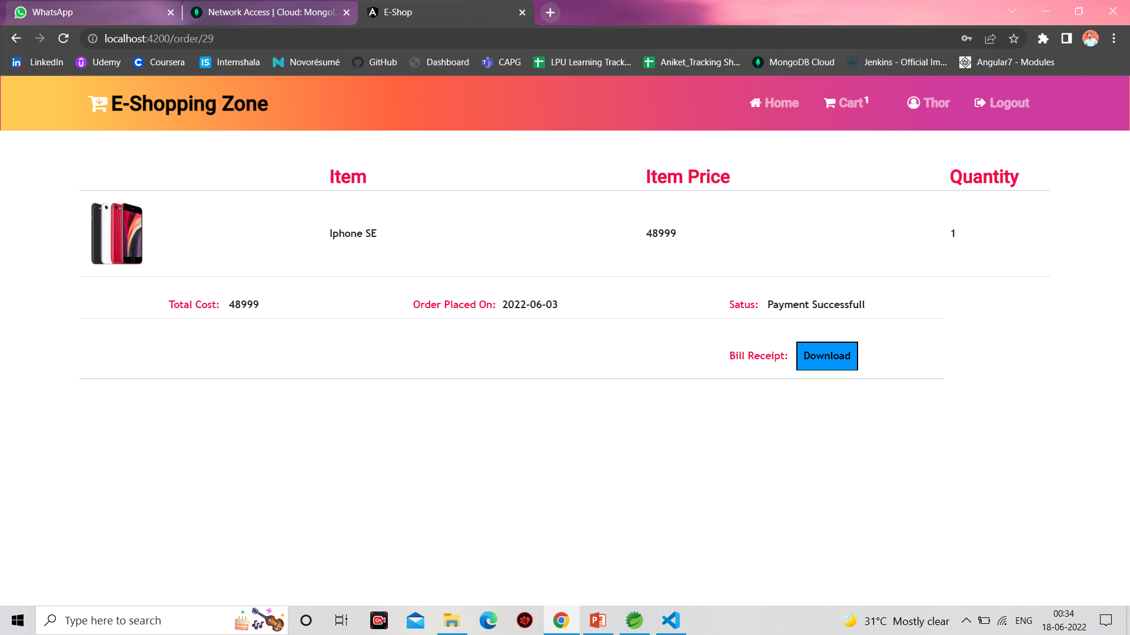
Order Page:-

Slide 17
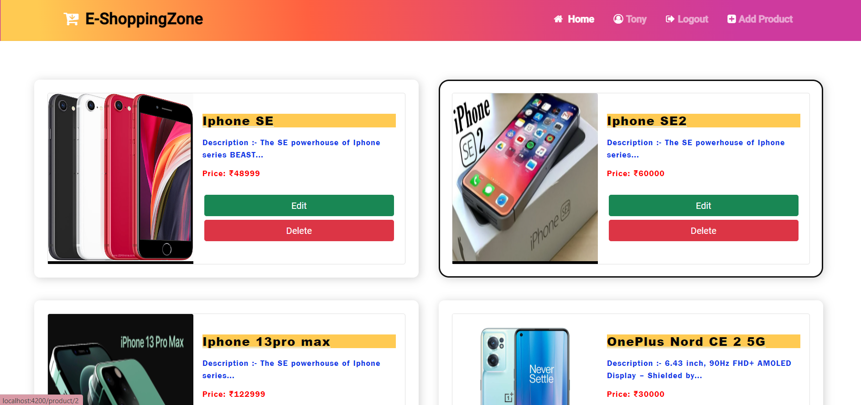
Merchant Home Page:-

Slide 18
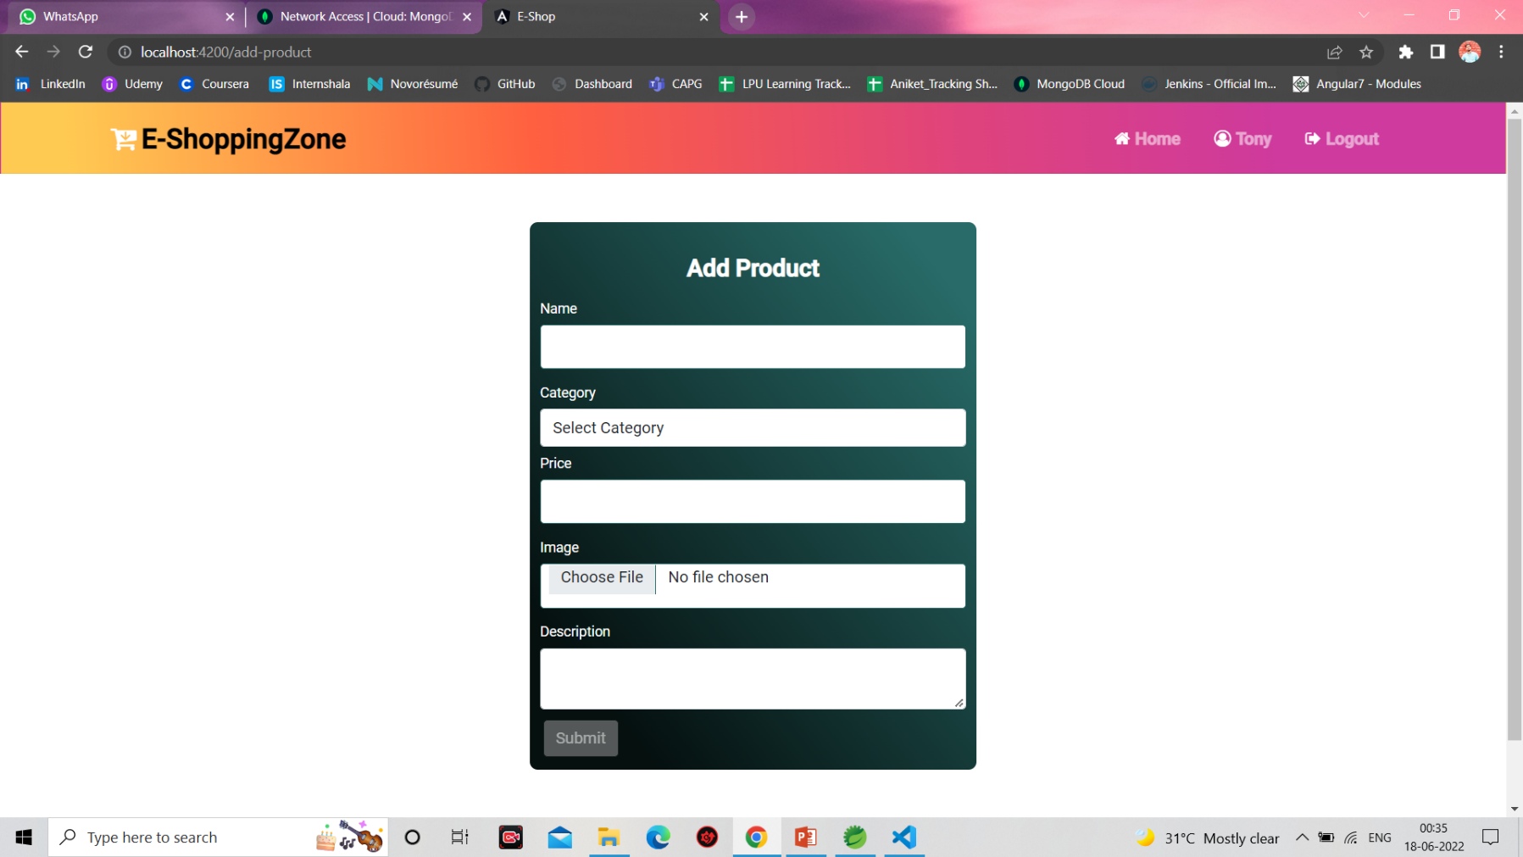
Add Product Page:-

Slide 19
Thank You

